Slide 1
The rediscovered Helsingør Atlas: a miniature,
inscrutable maverick
among 15th century portolan charts
Tony Campbell
[Draft version June 2025]
with thanks to Thorbjørn Thaarup and Joaquim Alves Gaspar
and to the MEDEA-CHART Database without which this would not have been possible

Slide 2
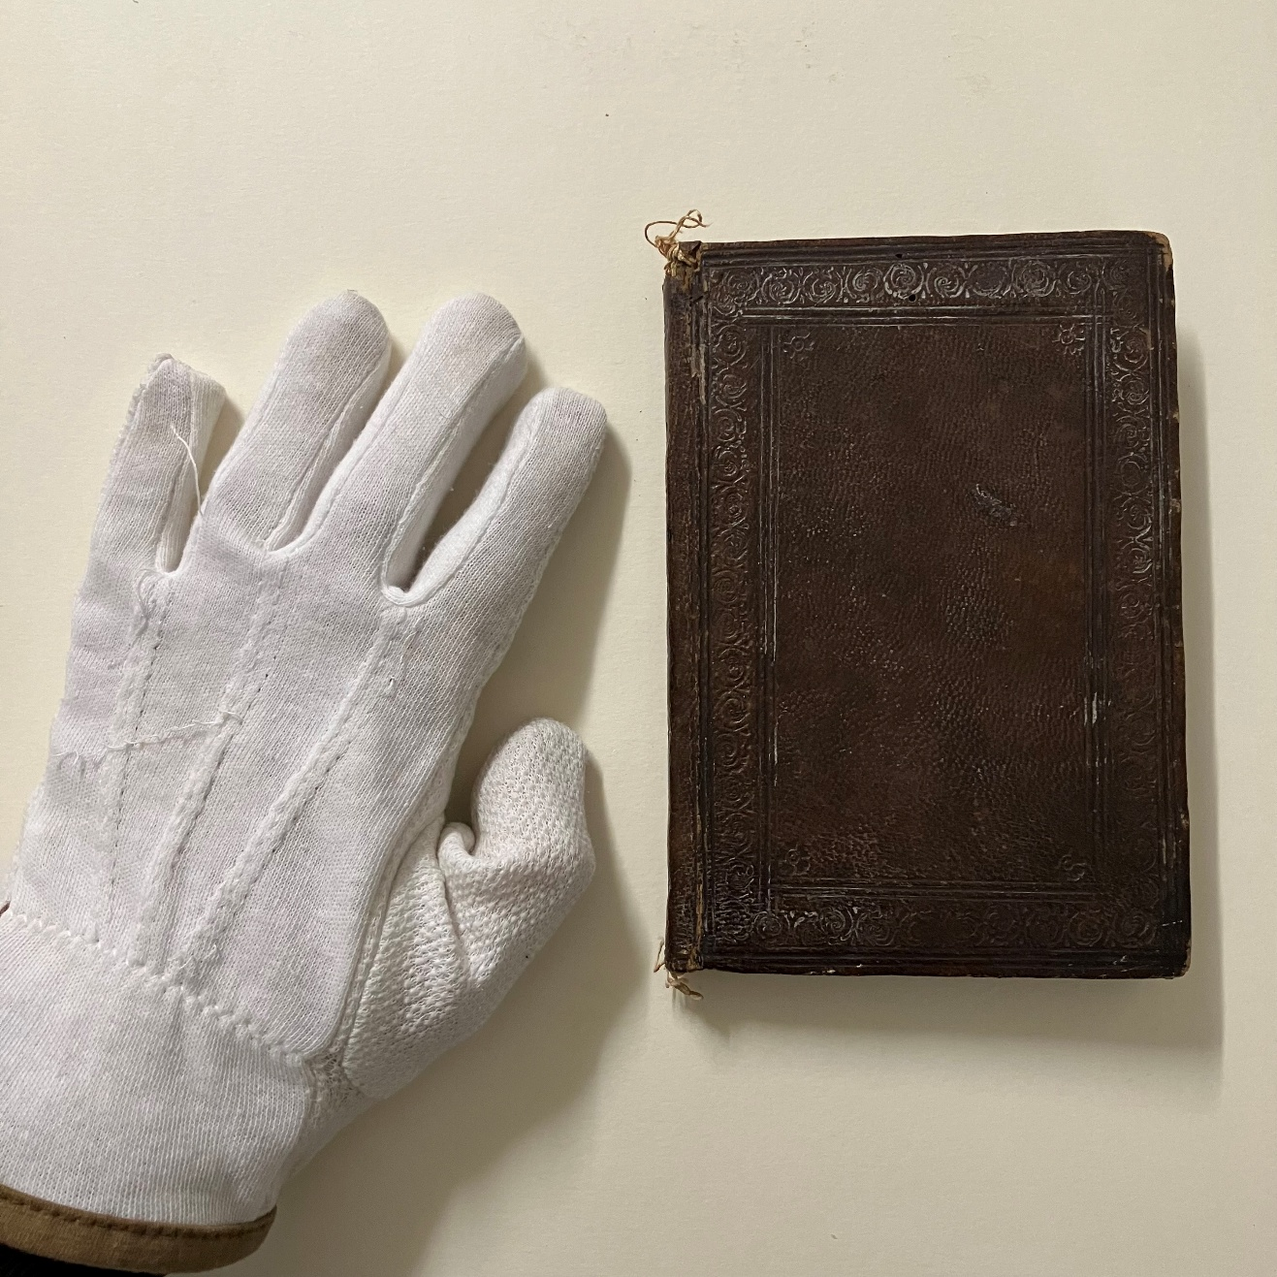
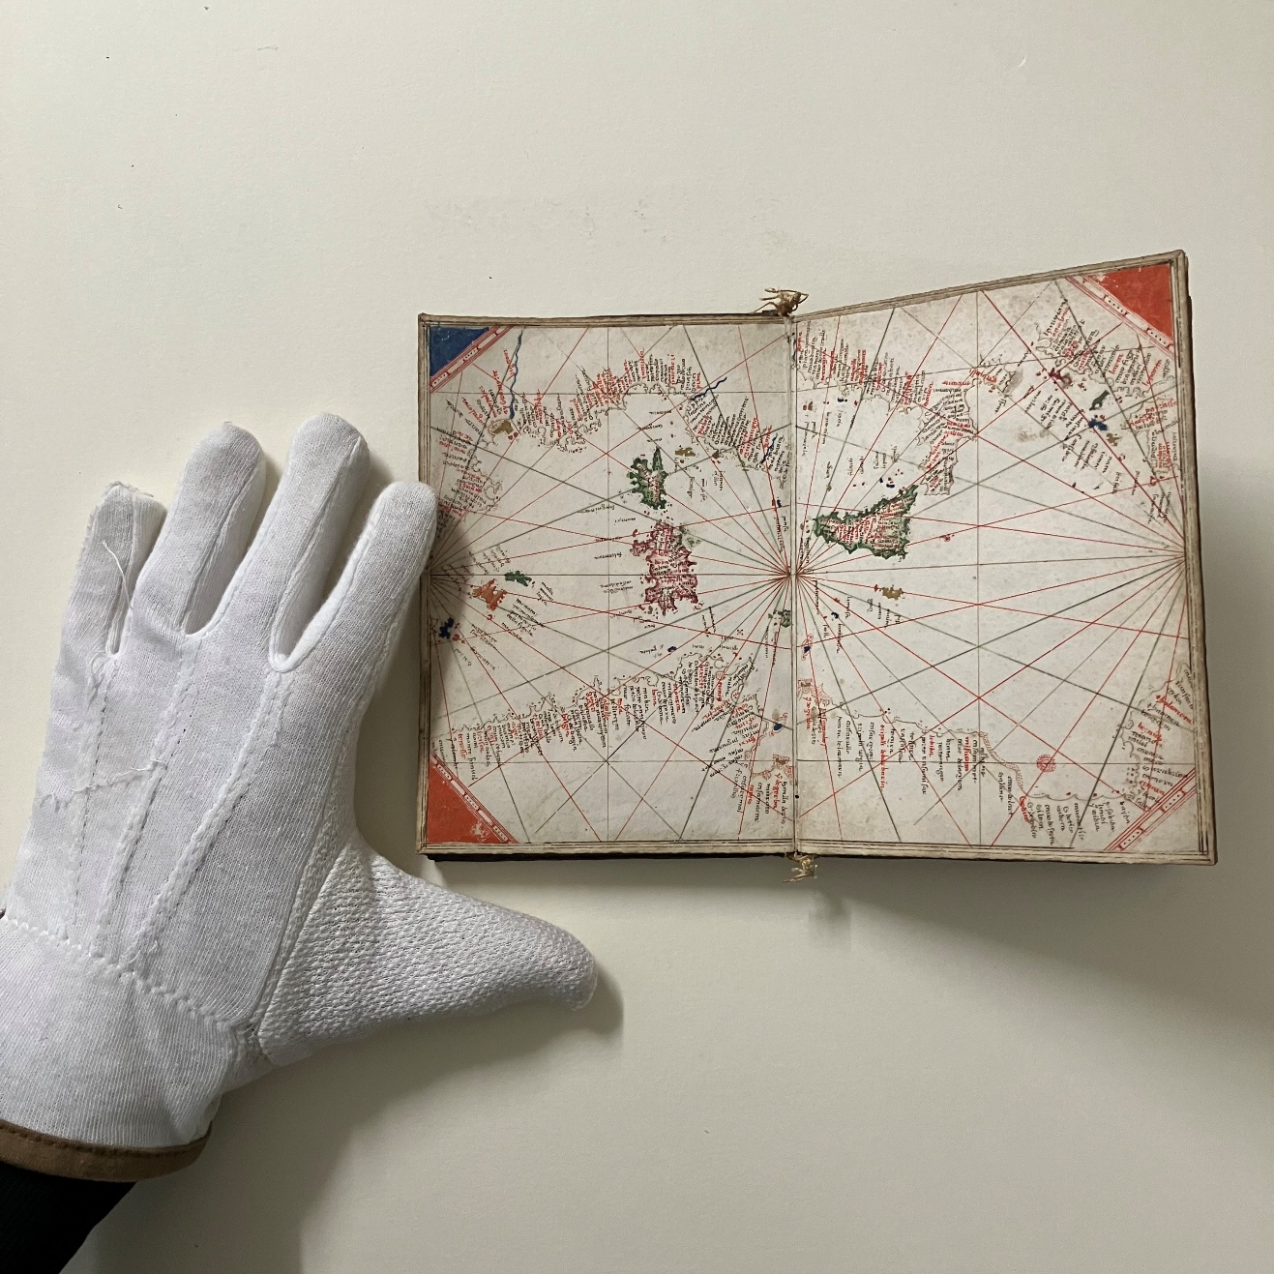
The size of the Helsingør Atlas
With thanks to Thorbjørn Thaarup, curator at the Danish Maritime Museum, for these photographs (and his hands)
as well as other invaluable assistance

Slide 3
The binding and stamped top-edge of the Helsingør Atlas
https://medea.fc.ul.pt/view/atlas/712 (with thanks to Thorbjørn Thaarup)

Slide 4
The Helsingør Atlas
M/S Museet for Søfart [M/S Maritime Museum of Denmark], 1948:0182
https://medea.fc.ul.pt/view/atlas/712
(montage of the five sheets by Joaquim Alves Gaspar. August 2024}

Slide 5
The repeated triangle pattern
The simple design used for the infill of the triangular scale bar on sheet 2.
Note that the dots for the miles have been left out in this case
Helsingør Atlas
https://medea.fc.ul.pt/view/atlas/712

Slide 6
Beccari and Benincasa
compared
Grazioso Benincasa, 1461
Florence, Arch. di Stato, C.N. 5
https://medea.fc.ul.pt/view/chart/148
Battista Beccari, 1435
Parma, Arch. di Stato Bib.Pal., II,21,1613
https://medea.fc.ul.pt/view/chart/72

Slide 7
The source for the Helsingør Atlas revealed
Luxoro Atlas, c.1420 https://medea.fc.ul.pt/view/atlas/168
Helsingør Atlas
https://medea.fc.ul.pt/view/atlas/712

Slide 8
The atlases compared
The East Mediterranean
Luxoro Atlas, c.1420 https://medea.fc.ul.pt/view/atlas/168
Helsingør Atlas
https://medea.fc.ul.pt/view/atlas/712

Slide 9
Contrasting compass line systems
Helsingør Atlas
https://medea.fc.ul.pt/view/atlas/712
Grazioso Benincasa, 1463
London, British Library, Add MS 18454
https://medea.fc.ul.pt/view/atlas/43

Slide 10
The handwriting of the Helsingør Atlas
‘e’ in two separate strokes
fallen over capital ‘S’
‘d’ with a curl
‘r’ like the number 2
‘z’
‘x’
short ‘s’ used at the end as well
alternate ‘r’ in
lartas and tripolli
dotted ‘i’
Guadalquivir(q)
capital ‘G’: the only other capitalised initial letter
long ‘s’ used occasionally
short ‘s’ within a word
contraction for San[to] Tomao

Slide 11
The angle of the modern (short S)
no lean
slight lean
heavy lean
Beccari, 1403
Medea /chart/81
Vallseca, 1439
Medea /chart/90
The two breaks in the letter may be a Vallseca characteristic
Helsingør Atlas - but nowhere else
Medea /atlas/712

Slide 12
The corner triangles
Vatican, Vat.Lat.9015. attributed to Giacomo Ziroldi (Giroldi), 1425-50. Medea /atlas/24
Benincasa 1463
Medea /atlas/43
Helsingør Atlas
Medea /atlas/712

Slide 13
Battista Beccari, 1435
Parma, Arch. di Stato , Bib.Pal., II,21,1613
https://medea.fc.ul.pt/view/chart/72
Blue rivers
Helsingør Atlas
https://medea.fc.ul.pt/view/atlas/712
Grazioso Benincasa, 1461
Florence, Arch. di Stato, C.N. 5
https://medea.fc.ul.pt/view/chart/148

Slide 14
Versions of the ‘Lacus Fortunatus’ explanation
Vesconte, c. 1321
Medea /atlas/122
Venetian, 1425-50
Medea /atlas/32
Parma ASBP, II,32,1624
Helsingør Atlas
Medea /atlas/712

Slide 15
Toponyms being truncated at the outer edge (Helsingør Atlas)
Sheet 5
Sheet 6
and the origin of the compass lines curtailed
Both Sheet 3

Slide 16
Ireland
Beccari 1435
https://medea.fc.ul.pt/view /chart/72
Helsingør Atlas
https://medea.fc.ul.pt/view/atlas/712
Benincasa 1461
https://medea.fc.ul.pt/view /chart/148

Slide 17
Using the British Isles for comparison
Helsingør Atlas
https://medea.fc.ul.pt/view/atlas/712
Grazioso Benincasa, 1461
https://medea.fc.ul.pt/view/chart/148
Beccari 1435
https://medea.fc.ul.pt/view /chart/72
Note the different way the Helsingør Atlas treats ‘Inglaterram’ [England]

Slide 18
The first sheet
Helsingør Atlas
https://medea.fc.ul.pt/view/atlas/712
Note the amount of unused space above Scotland

Slide 19
Omissions on the Helsingør Atlas
(in north-west Iberia)
Sheet 1
Pontevedra: missing below
Rio Minho: missing below
Sheet 2
Lo padron: missing above
Helsingør Atlas
https://medea.fc.ul.pt/view/atlas/712

Slide 20
The most extensive overlap
(lavelona – coron)
Sheet 6
Sheet 4
san nicolo is shown above larta on sheet 4 but is missing from sheet 6
Helsingør Atlas
https://medea.fc.ul.pt/view/atlas/712

Slide 21
The Venice vignettes
Helsingør Atlas
Medea /atlas/712
Note the lack of the name Venice by the three-fingered symbol, shown in red on the Luxoro Atlas
Luxoro Atlas, c.1420
Medea atlas/168
Beccari 1435 (Genoa) Medea chart/72
Vallseca 1449 (Catalan) Medea chart/61
Pareto 1455 (Genoa) Medea chart/45
Italian chart in Barcelona, Arch. Corona de Aragón
Medea chart/371

Slide 22
Straight or rounded coastline either side of Venice
Luxoro Atlas (Cesanis),c.1420 Medea /atlas/168
Pinelli-Walckenaer Atlas British. Library Add. MS 19510. Medea/atlas/143
Beccari 1435
Medea /chart/72
Parma, Arch. di Stato Bib.Pal. II,32,1624
Medea /atlas/32
Helsingør Atlas
Medea /atlas/712
Benincasa 1461
Medea /chart/148

Slide 23
Moving the Black Sea to the West
Helsingør Atlas
Medea/atlas/712
Which Benincasa would do for his 1463 atlas but not this 1461 chart
Medea /chart/148

Slide 24
Curtailments of the West African coast
Luxoro Atlas (Cesanis),c.1420 Medea /atlas/168
Helsingør Atlas
Medea /atlas/712
Cesanis chart, 1421 Medea /chart/471

