Slide 1
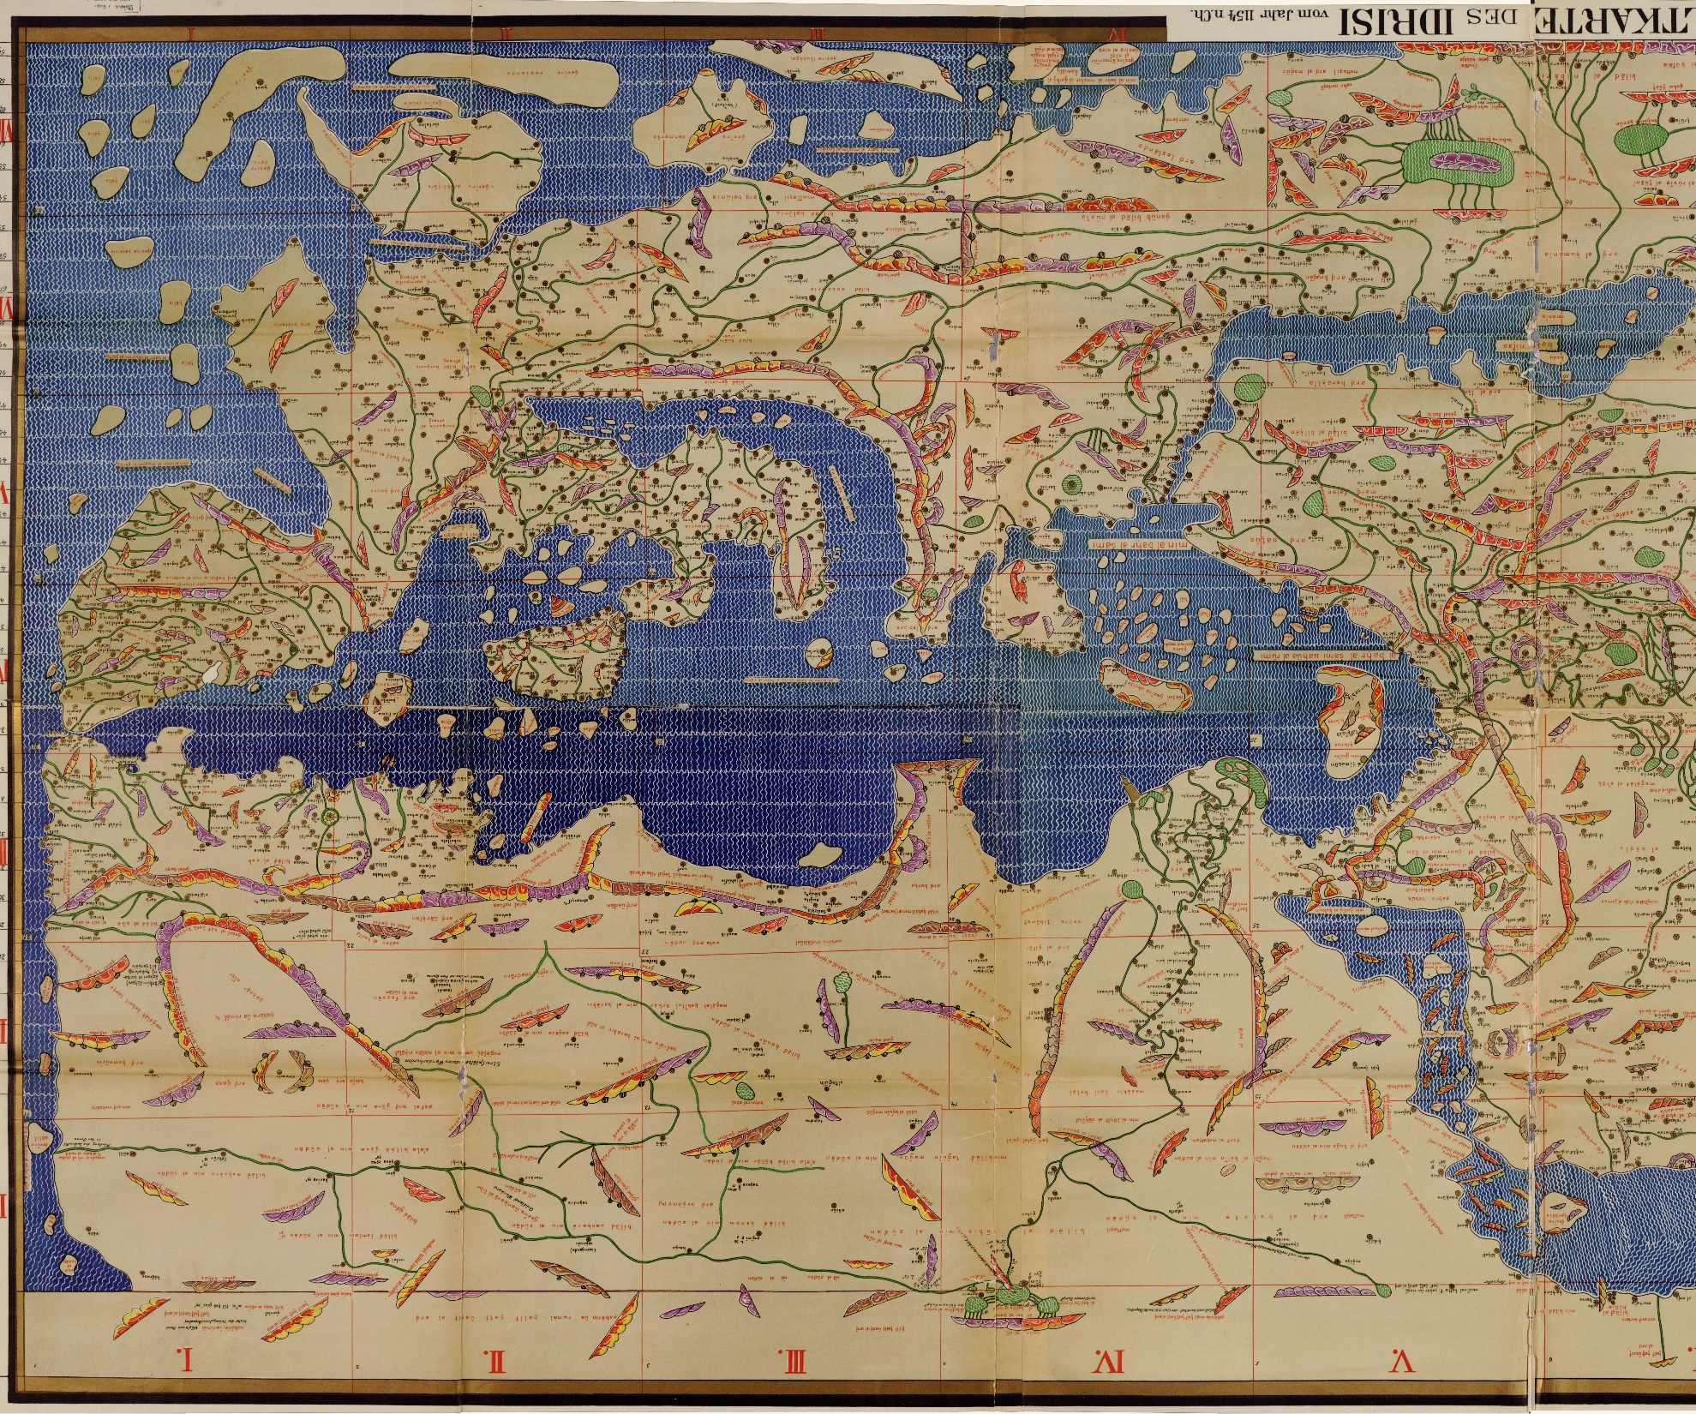
The western half of
Mohammed al-Idrīsī’s Charta Rogeriana, 1154

Slide 2
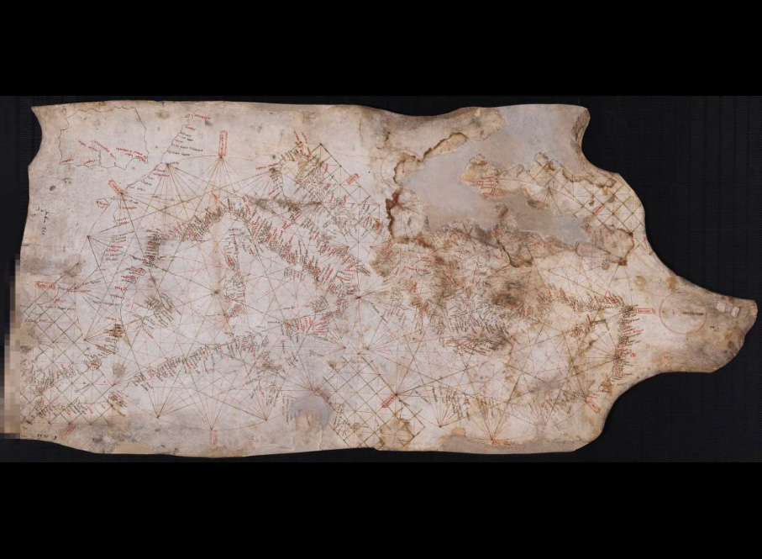
Carte Pisane, c.1270
Bibliothèque Nationale de France,
Rés. Ge. B. 1118

Slide 3
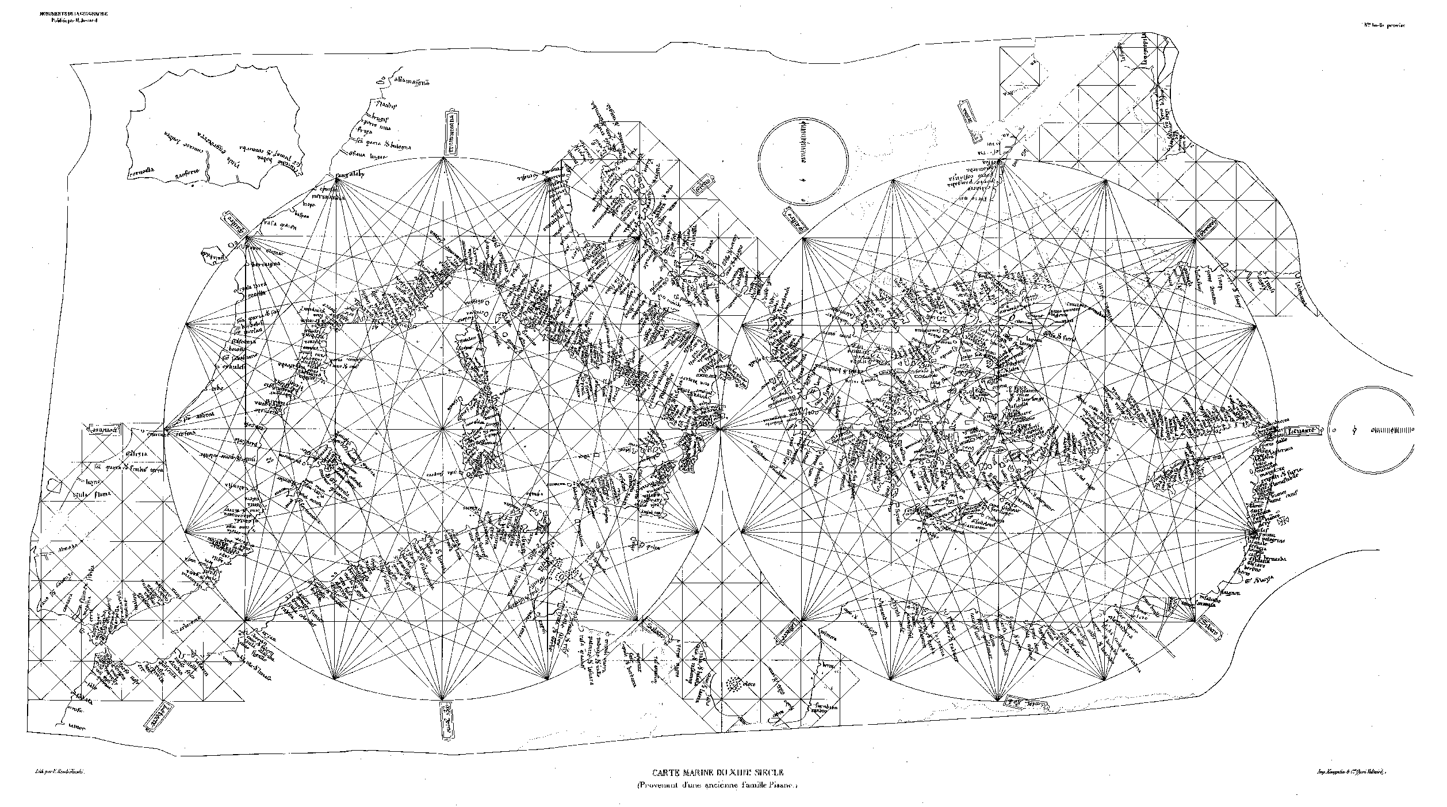
Carte Pisane (c.1270)
Re-drawing for Jomard 1852
(including detail now missing, e.g. from the Black Sea)

Slide 4
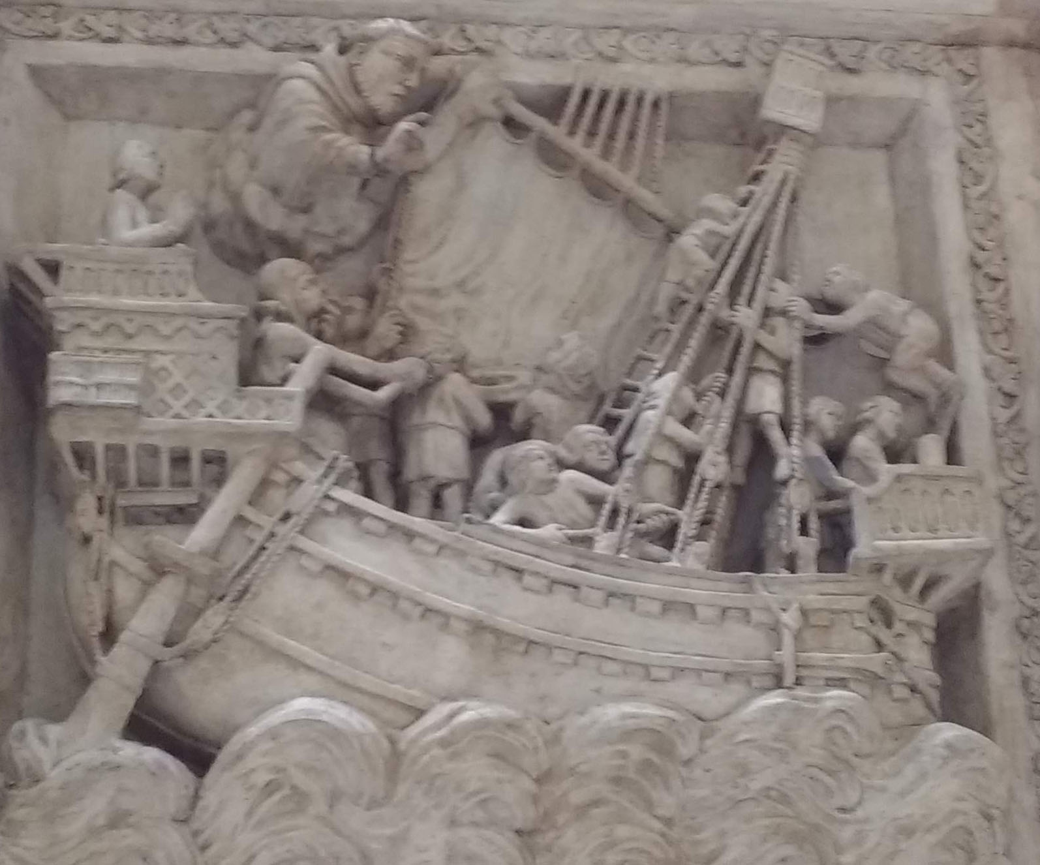
Tomb of St Peter Martyr, Milan. 1338 by Giovanni di Balduccio
Plaster cast, by Eduardo Pierotti, 1869
Courtesy of the Victoria and Albert Museum

Slide 5
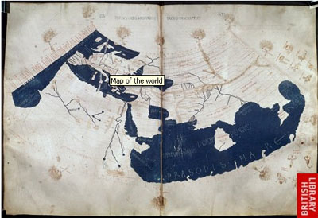
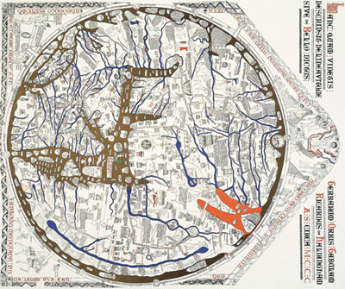
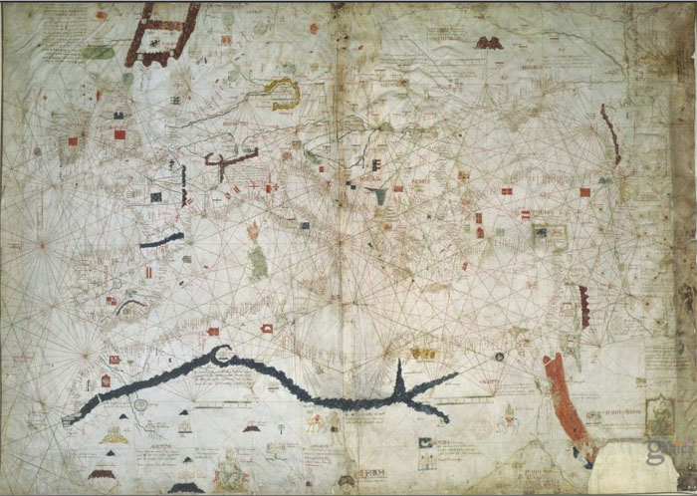
Ptolemy, 15th century
(British Library, Harley
MS 7182)
Hereford Mappamundi c.1300
(Hereford Cathedral)
Angelino Dulceti, 1339 (Bibliothèque Nationale
de France, Rés. B. 696)

Slide 6
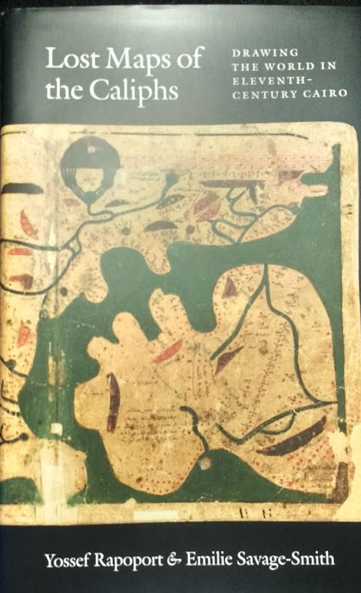
2018:
about the ‘Book of Curiosities’

Slide 7
2019

Slide 8
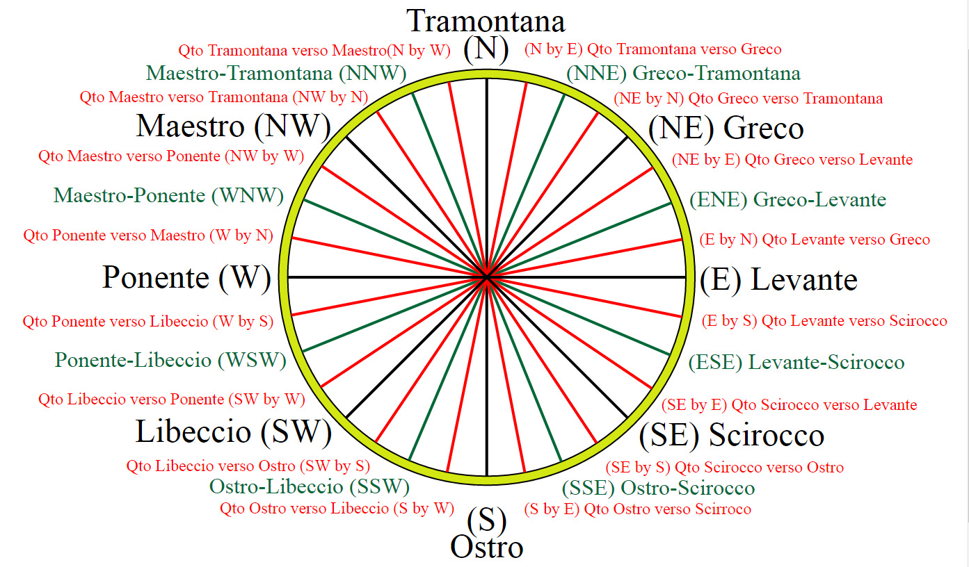
32-point wind compass

Slide 9
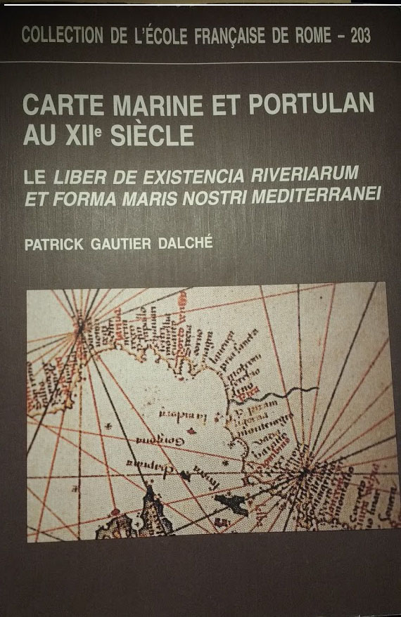
1995

Slide 10
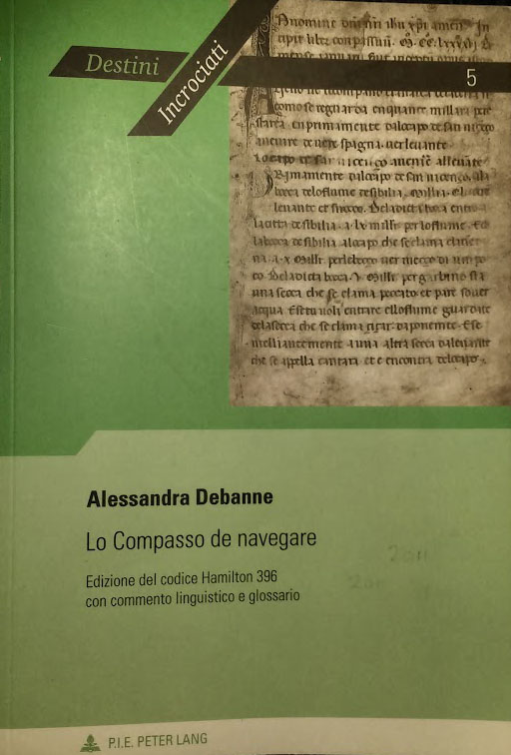
2011

Slide 11
The Liber’s pelagic courses for the central Mediterranean
(Patrick Gautier Dalché, 1995)

Slide 12
Pelagic courses from the Liber
Showing the four courses ending at Tripoli and the single one from Alexandria

Slide 13
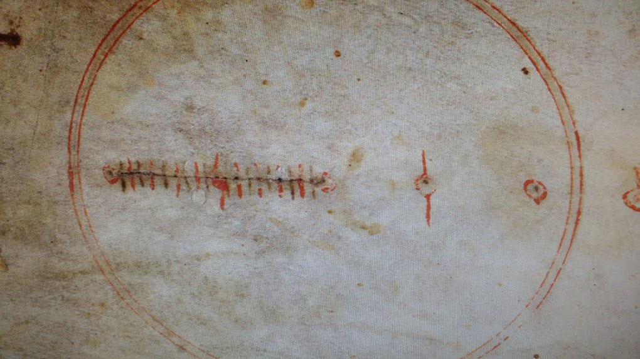
The scale bar from the Carte Pisane, c.1270
Note that each of the smallest divisions represented 5 miles so that each group of ten covered 50

Slide 14
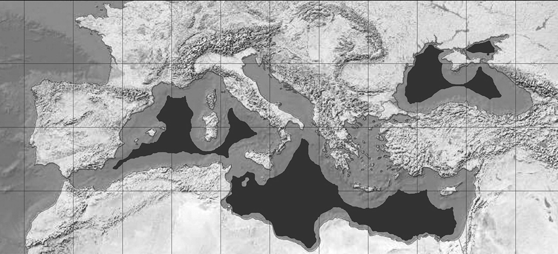
Visibility in the Mediterranean
Grey areas provided a ship’s crew with sight of some land at least; when in a black zone no land will be visible at all
Courtesy of Joaquim Alves Gaspar and Imago Mundi Ltd. From Imago Mundi 71:1 (2019) p.12

Slide 15
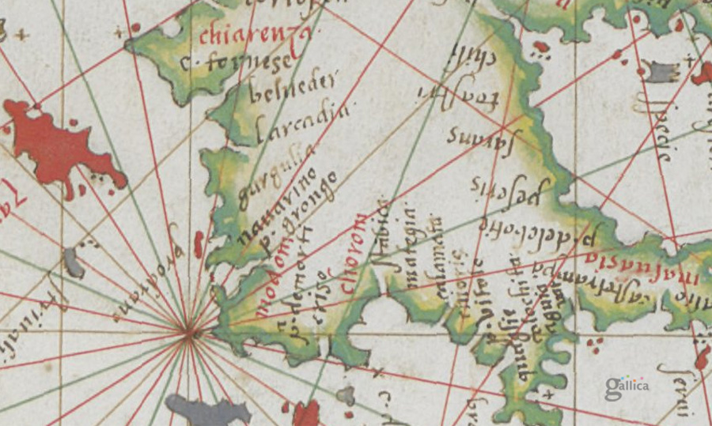
Standard colours for the compass directions:
black (for primary directions) then green, last red
black red green red black red
green
red
black
Diogo Homem, 1574 (Bibliothèque nationale de France, DD. 2006)

Slide 16
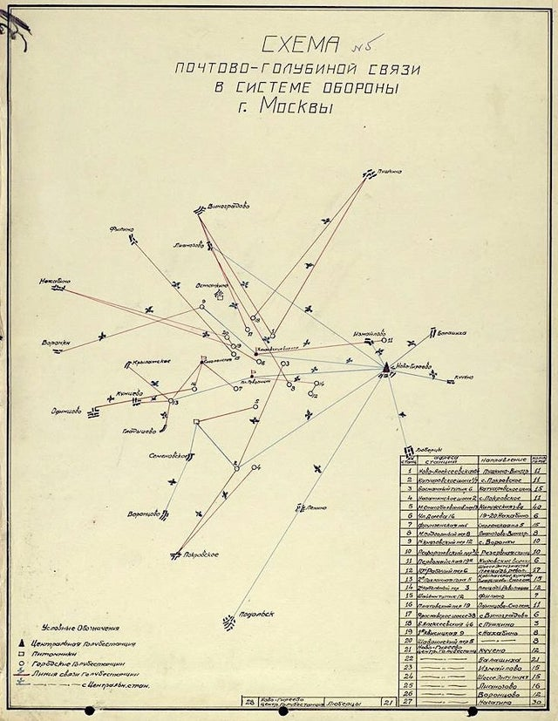
Scheme of pigeon post communications in the defence system of Moscow (1941)
Courtesy of Reddit.com

Slide 17
Patrick Gautier Dalché’s introduction to the Liber de existencia riveriarum (p.81)
Lines 191-197 of the Liber’s transcribed text

Slide 18
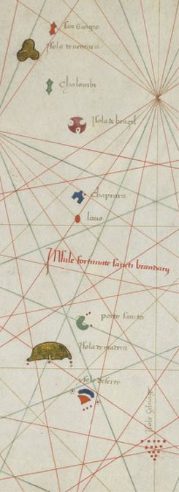
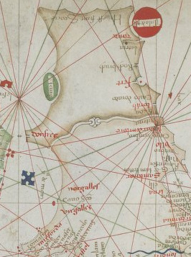
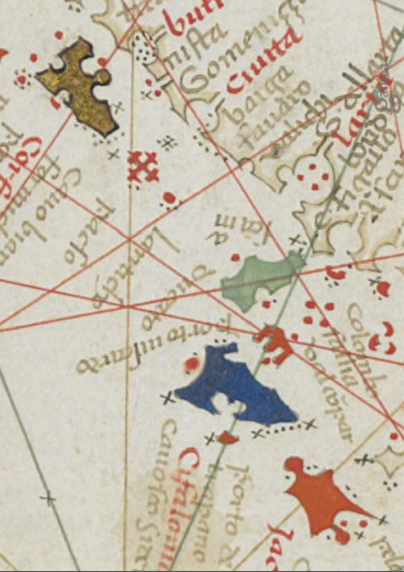
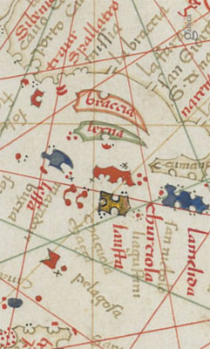
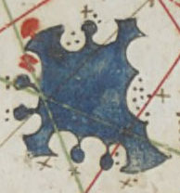
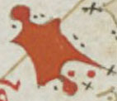
Brazil
Scotland and the Isle of Man
Paxos
Dalmatian islets
Madeira
Zakynthos
Madeira and various mythical Atlantic islands
Skyros
Limnos
All details from: Grazioso Benincasa, 1466 or 1467 (Bibliothèque nationale de France)

Slide 19
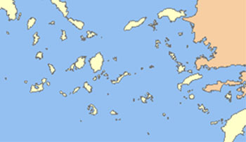
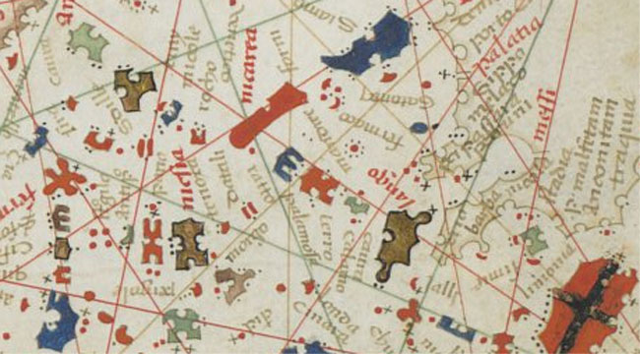
Which version of the southern Aegean would be easier to memorise?
modern outline
Benincasa 1467

Slide 20
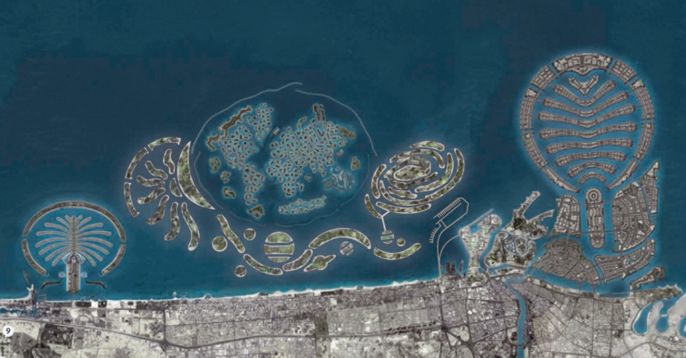
Dubai, ‘The Universe’
Did the architects realise they were continuing a long tradition?

Slide 21
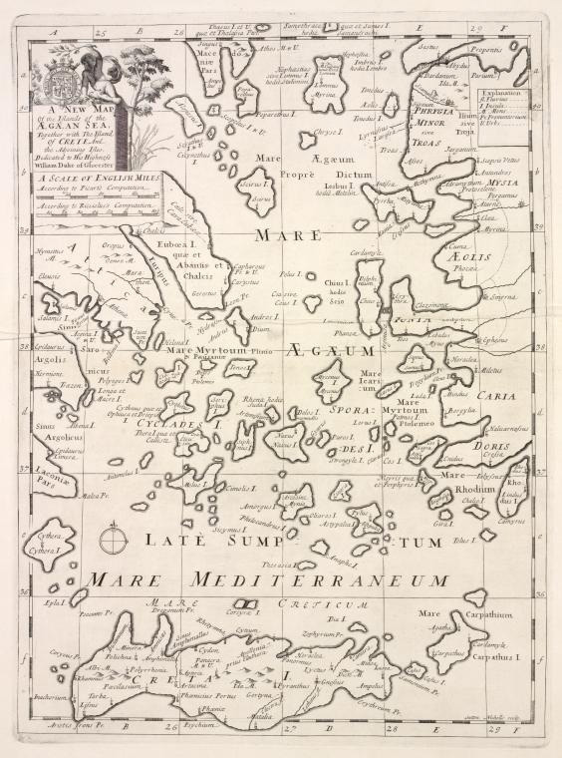
The shape of the Aegean, as taught to a future king
Edward Wells. New
Set of Maps both of Ancient and Present Geography, 1700.
Dedicated to his pupil in Christchurch, Oxford, William, Duke of Gloucester and son of the future Queen of England, who died that year, aged 11.
New York Public Library Map Division

Slide 22
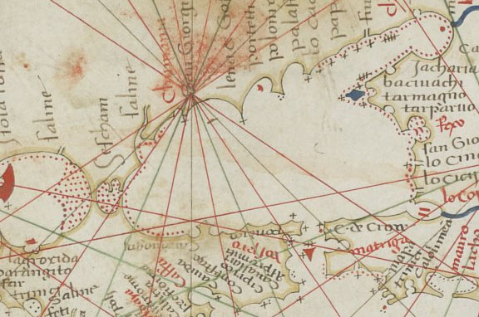
The Sea of Azov
different types of navigational symbols
The coded dangers:
Black cross = rock
Line of those = reef
Red dots = sand or mud shoal
Grazioso Benincasa, 1466 (Bibliothèque nationale de France, DD. 2779)

Slide 23
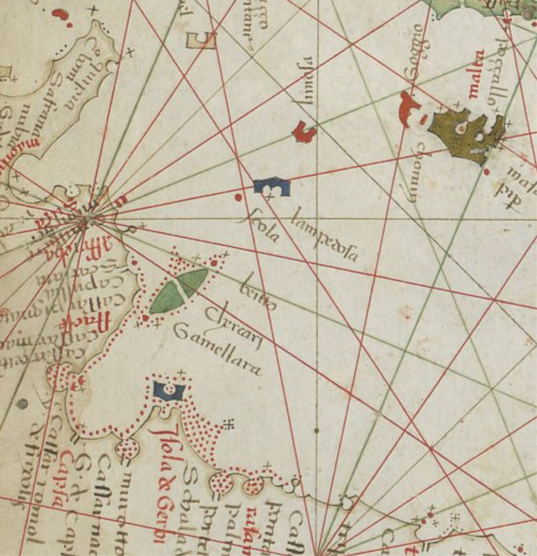
Demonstrating the different types of navigational symbols for dangers
Tunisia and Libya
Grazioso Benincasa, 1466 (Bibliothèque nationale de France, DD. 2779)

Slide 24
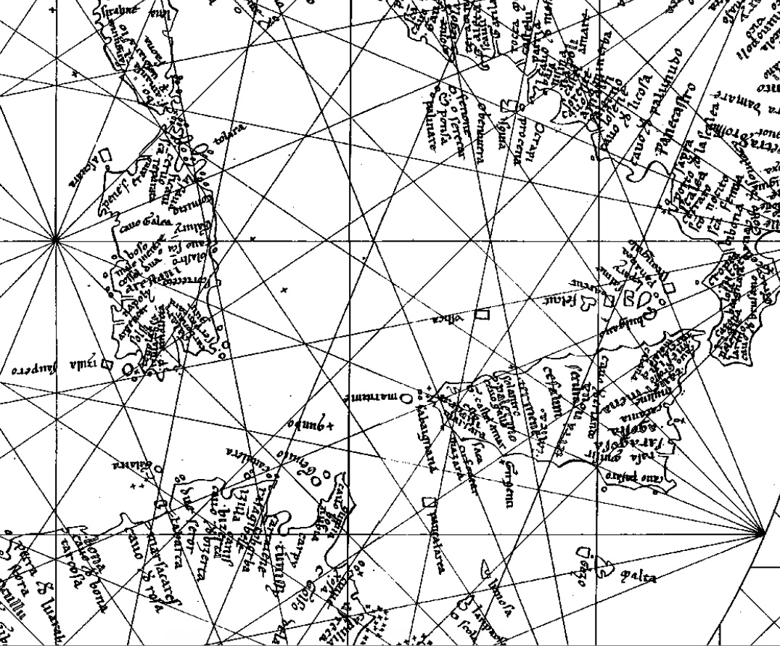
Carte Pisane, c.1270
from the 1852
facsimile made for Santarem
Naples
quilbo = Skerki
Showing the route from Tunis to Naples with the long and dangerous Skerki Bank barring the way
Tunis

Slide 25
Overlapping incidence of toponyms for the Mediterranean litoral
Coloured figures are the overlaps shown as %
Text or Chart | Total names | Unique | Red ‘standard’ | Total (minus ‘standard’) | LIBER | LO COMPASSO | CARTE PISANE | CORTONA
‘Liber’ | 593 | 17 | 90 | 503 | ----- | 51
‘Lo compasso’ | 517 | 24 | 83 | 434 | 59 | -----
Carte Pisane | 629 | 74 | 99 | 530 | 42 | 44 | -----
Cortona | 492 | 49 | 72 | 420 | 43 | 51 | 78 | -----
Vesconte 1311-13 | 752 |  |  | 645 | 36 | 41 | 64 | 40
Lucca | 616 | 62 | 95 | 521 | 42 | 49 | 76 | 56
Riccardiana | 681 | 7 | 106 | 575 | 40 | 47 | 64 | 51

Slide 26
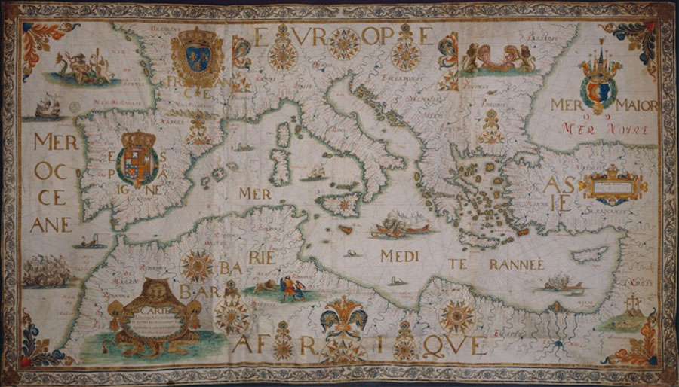
A very late traditional portolan chart
Jean-François Roussin, 1674 (Bibliothèque nationale de France, S.H. Archives 44)
(the black circle, linking the intersection points marked by compass roses, has been added)

Slide 27
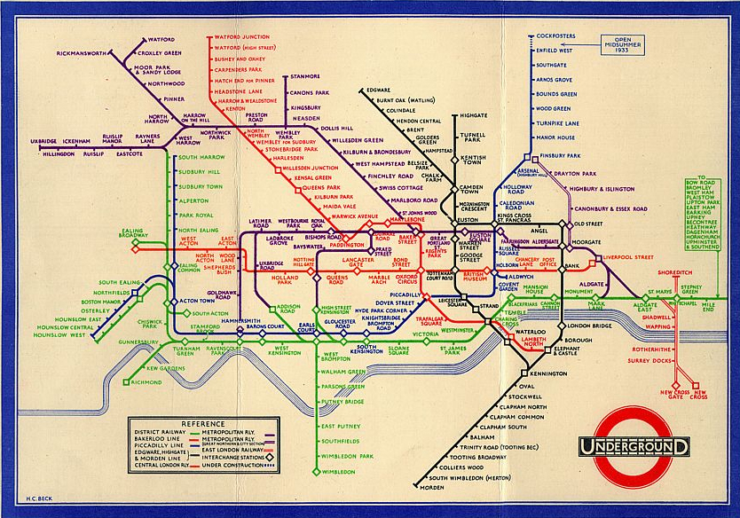
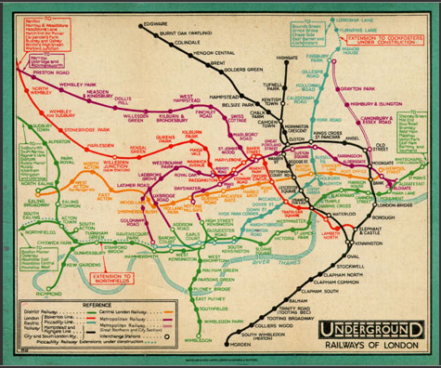
The London Underground Map
F.H. Stingemore, c.1930
Harry Beck, 1933

Slide 28
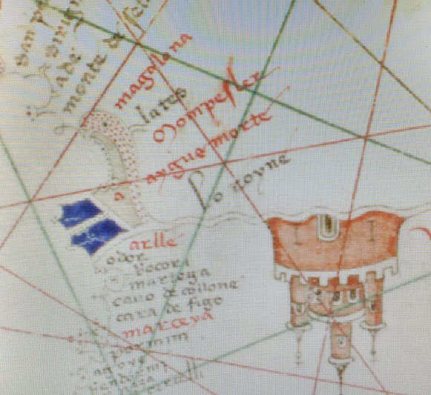
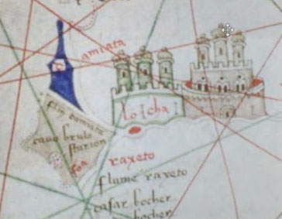
Initial letters repeated or separated and turned, thus showing that the convention
was not understood by Francesco Beccari in 1403 (see note 512)
aygue morte has its initial ‘A’ repeated on the island
Damiata has the capital initial ‘D’ placed on the island but rotated

Slide 29
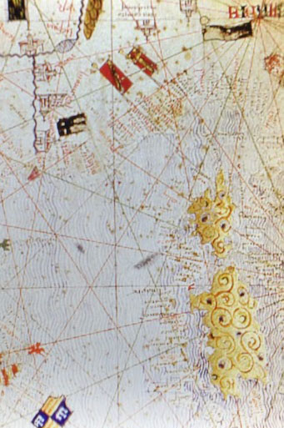
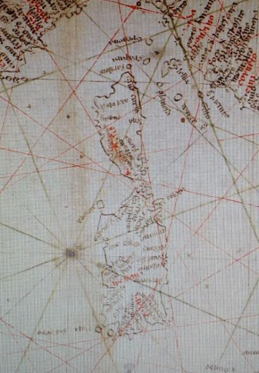
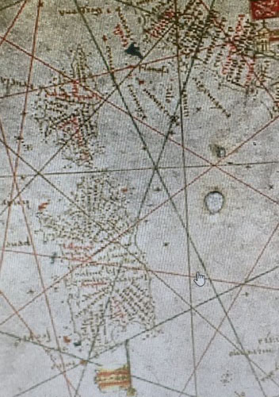
‘Functional’ or ‘Augmented’?
Functional: Carte Pisane, c.1270
intermediate: Soler, 1385
Augmented: Catalan Atlas, 1375

Slide 30
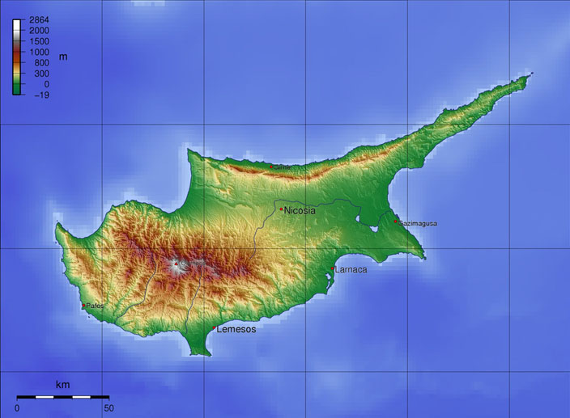
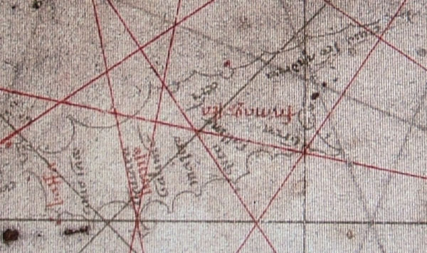
Early outlines for Cyprus and Crete
Both from Pietro Vesconte, 1318 (Venice, Museo Correr, Port.28)

Slide 31
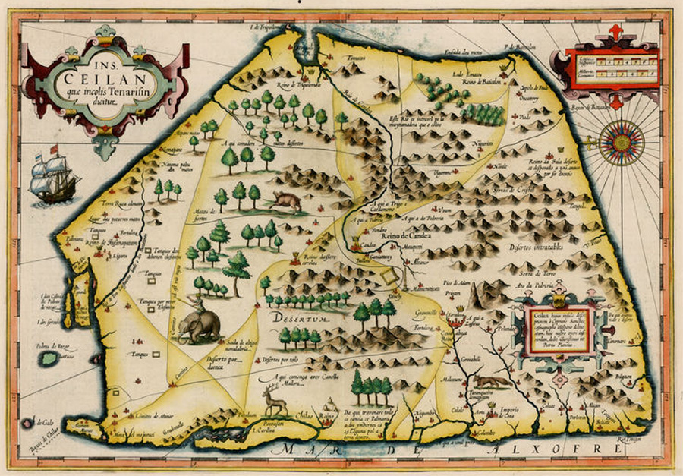
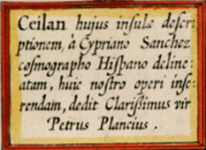
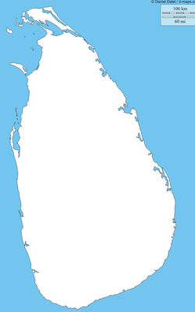
Ceylon (Sri Lanka) by Cypriano Sanchez, published by Hondius, 1606
Courtesy of Barry Lawrence Ruderman

Slide 32
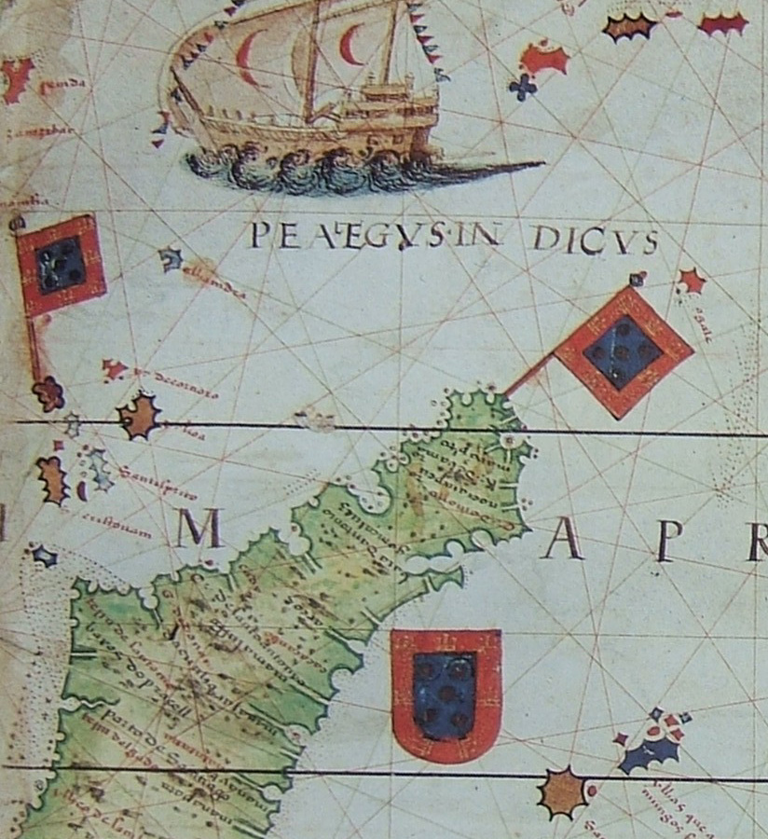
Other examples of potentially ‘mnemonic’ island shapes
Madagascar
Miller Atlas, 1519 (Bibliothèque nationale de France, DD. 683 / AA. 640)

Slide 33
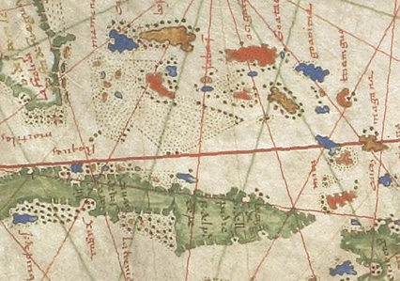
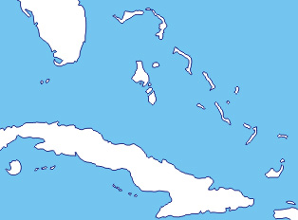
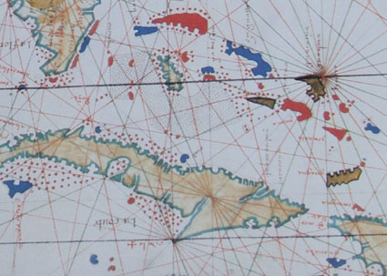
The Bahamas
Jorge Reinel, c.1550 (Bibliothèque nationale de France, B. 1148)
The ‘Dauphin Atlas’ c.1538 (Royal Library, The Hague)
ex Robert Putman, Early Sea Charts (1983), pl. 46

Slide 34
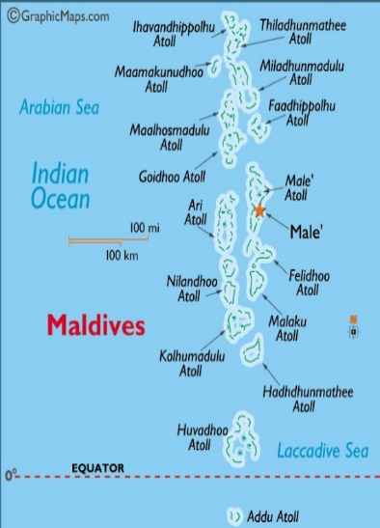
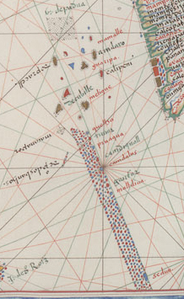
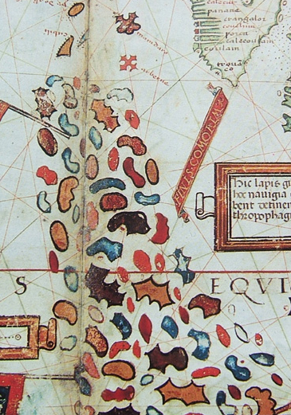
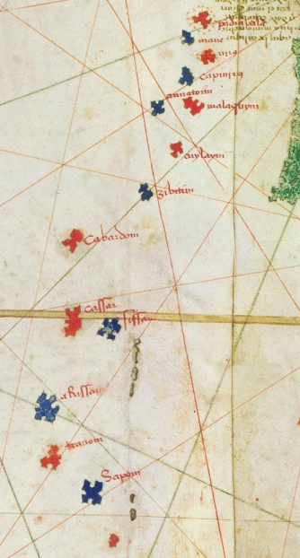
Different ways of representing the Maldive Islands
Vaz Dourado, c.1570 (Huntington Library, San Marino)
Miller Atlas, 1519 (Paris, Bibliothèque nationale de France)
Cantino Map, 1502 (Biblioteca Estense, Modena)

Slide 35
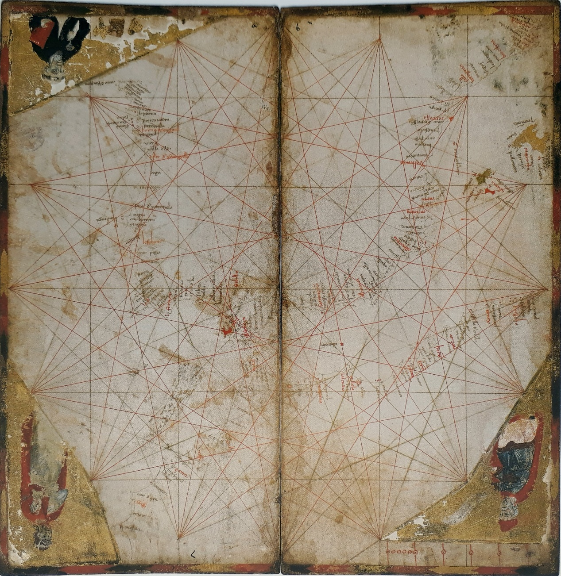
Non-navigational features on early portolan charts
Avignon chart
Vesconte 1318, Civico Museo Correr, Venice
Lucca chart

Slide 36
Was the second Sanudo world map precisely copied from the first?
And, if so, would that point to the chartmaker Pietro Vesconte as the copyist?
Vatican, Pal. Lat. 1362a
Vatican, Vat. Lat. 2972

Slide 37
Sanudo map: deterioration
Presentation copy
Vatican, Pal. Lat. 1362a
Late copy
Brussels, KBR, MS 9347-8

Slide 38
William Berry (1685-8). Dedicated to King James II

Slide 39
A modern outline
Freebible images.org Knowing the Bible
William Berry, 1685-8, supposedly copied from Nicolas Sanson
Carte Pisane (c.1270). Re-drawing for Jomard 1852 (including detail now missing, e.g. from the Black Sea)

